Slide 1
Bike Rentals Analysis
Project: NEXTHIKES IT SOLUTIONS
Presented by: Arpit Vats
A professional walkthrough of the workbook structure, KPIs, visual analytics, anomaly detection and forecasting.
Notes:
Opening: this deck turns the Excel dashboard into a story about when, why and who rents bikes.
1

Slide 2





Objectives of Project
01
02
03
04
Understand demand
Segment customers
Explain the drivers
Detect and predict
Measure total, average and peak rentals across hours, days and weeks.
Compare casual and registered riders and how their behaviour differs.
Test the effect of weather, holidays and time of day on rentals.
Flag unusual hours and forecast demand through 31 March 2011.
OBJECTIVES
4
2
Notes:
Each objective maps to one or more dashboard views.
4

Slide 3
Excel techniques that helped in building the dashboard
01
02
03
Data preparation
Excel functions
Pivot tables and charts
1,000 hourly records with date, weekday, weather and customer fields.
SUM, AVERAGE, MIN, MAX, COUNT, VLOOKUP and HLOOKUP for core KPIs.
Trend, hourly and weather views with slicers and a timeline.
04
05
06
Advanced visuals
Anomaly detection
Forecasting
Heatmap, funnel, waterfall and scatter plots for deeper patterns.
IQR and standard-deviation limits to flag extreme hours.
Excel forecast sheet with lower and upper confidence bounds.
Bike Rentals Analysis | Jan–Feb 2011
4
APPROACH
3
Notes:
From cleaning to forecasting, all inside one workbook.
5

Slide 4
1,000
45
DataSet Overview
13
4
  There are a total of 1000 records of Bike Rentals in the Final Dataset
  Each record holds the hour, weekday, holiday flag, weather alert, temperature, humidity, wind, and customer counts.
  An Excel dashboard summarises everything with KPIs, pivot charts, slicers, and a timeline.
Rental Records
Days covered, 1 Jan – 14 Feb 2011
Variables captured per record
Weather alert levels tracked
4
Notes:
The dataset logs every rental hour with weather, holiday and customer type.
3

Slide 5
Dashboard Key Performance Indicators(KPI’s)
58,304
58.3
249
Total rentals
Average rentals per hour
Peak rentals in a single hour
53,383
4,921
62
Registered rentals
Casual rentals
Peak casual rentals in one hour (registered: 247)
6
KPI’s
5
Notes:
Headline numbers from the KPI block of the dashboard.
6

Slide 6
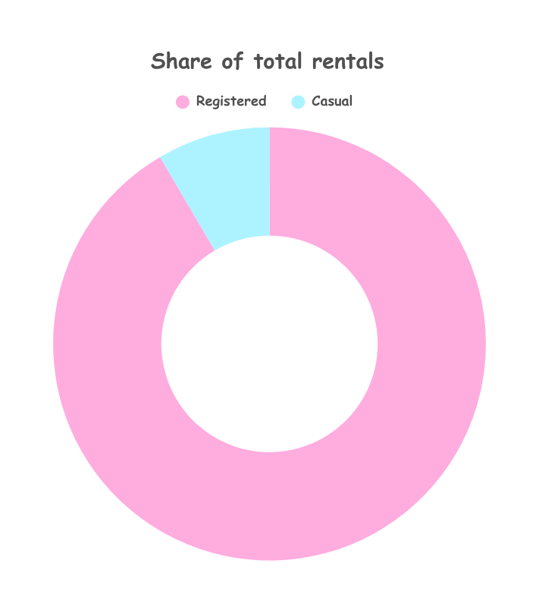
Customer Breakdown
91.6%
Registered Customers- 53,383
8.4%
Casual Customers-
4921
10.8x
Registered-to-casual ratio (53.4 vs. 4.9 per hour)
CUSTOMER COMPOSITION
6
Notes:
Doughnut chart from the dashboard: registered versus casual.
7

Slide 7
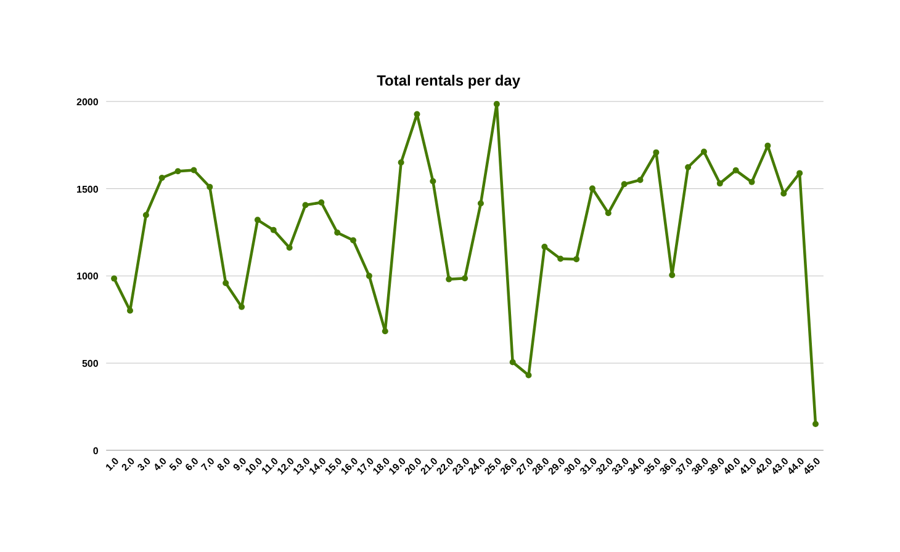
Daily rentals grew from January into February
1,985
Peak Day- 25th January
151
Lowest Day- 14th February(Last Day in Data)
+17%
Average daily rentals, 1–14 Feb vs. January (1,437 vs 1,232)
TREND OVER TIME
7
Notes:
Line chart of total customers per day.
8

Slide 8
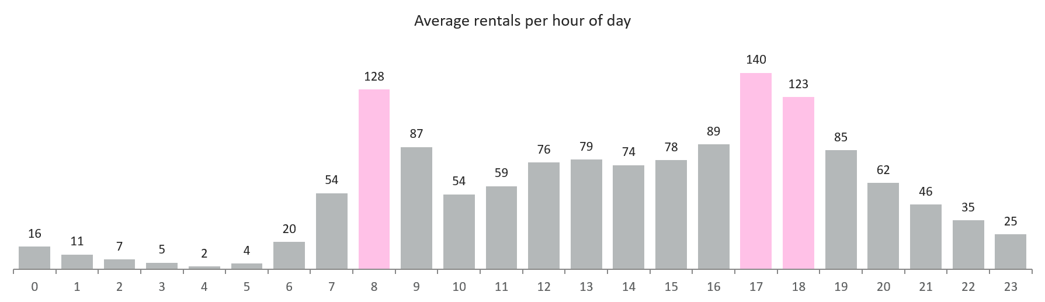
Demand follows the commute, with peaks at 8:00 and 17:00
17:00
08:00
28.9%
Busiest hour: 140 rentals on average
Morning peak: 128 rentals on average
Of all rentals fall in just three hours: 8:00, 17:00 and 18:00
HOUR OF DAY
8
Notes:
Average customers by hour of day.
9

Slide 9
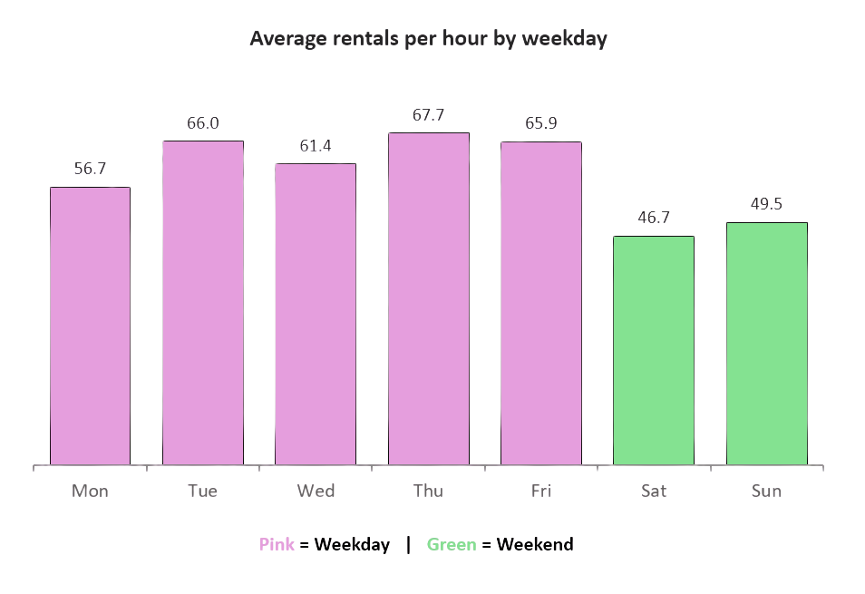
Weekdays outperform weekends by 24%
63.3 vs. 48.1
Rentals per hour, weekday vs weekend
18%
Casual share on Sundays (Saturday 16%), against 4–6% midweek
DAY OF WEEK
9
Notes:
Weekday average 63.3 versus weekend 48.1 rentals per hour.
10

Slide 10
Weekdays peak at the rush hours, weekends at midday
Time block | Mon | Tue | Wed | Thu | Fri | Sat | Sun
Night (0-5) | 5 | 4 | 5 | 5 | 6 | 14 | 14
Morning (6-9) | 85 | 112 | 88 | 116 | 106 | 15 | 14
Midday (10-15) | 59 | 56 | 57 | 60 | 63 | 84 | 102
Evening (16-19) | 124 | 129 | 123 | 123 | 127 | 76 | 76
Late (20-23) | 41 | 43 | 52 | 52 | 44 | 40 | 28
Commuter pattern
Mon–Fri mornings reach 85–116 and evenings 123–129 rentals per hour.
Leisure pattern
Saturday and Sunday peak midday at 84 and 102.
Night riders
Weekend nights see 14 rentals per hour, against 4–6 on weekdays.
Average rentals per hour. Darker cells = busier.
RIDERSHIP HEATMAP
10
Notes:
Heatmap of average rentals by time block and weekday.
11

Slide 11
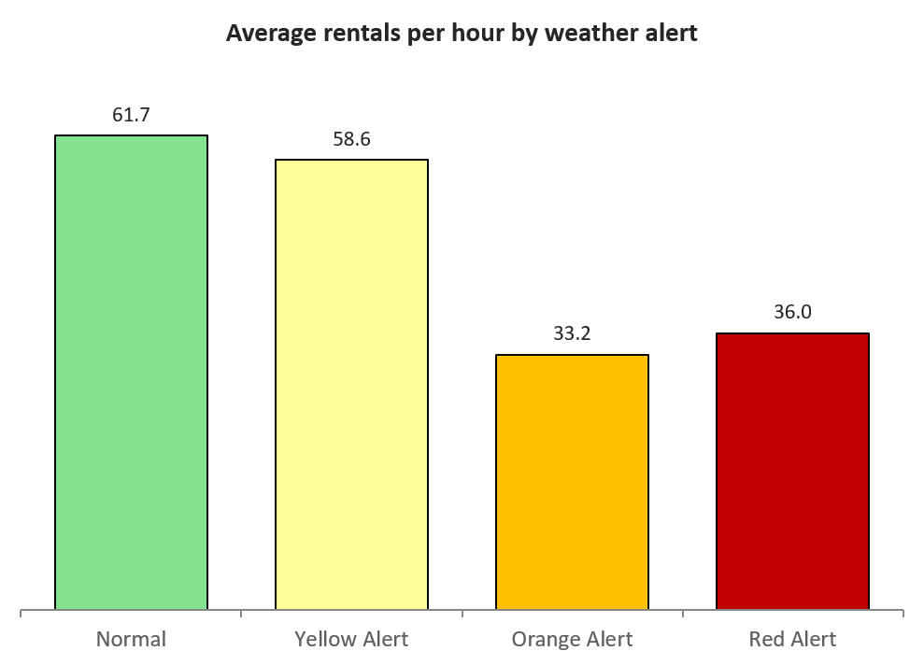
Orange alerts cut average demand by 46%
Normal weather carries the volume
606 of 1,000 hours and 64% of all rentals happen in normal conditions.
Yellow alerts barely matter
58.6 rentals per hour, only 5% below normal.
Orange alerts bite
33.2 per hour, with humidity near 0.87 versus 0.52 in normal weather.
Red alert is one record
Treated as an anecdote, not a trend.
WEATHER SITUATION
11
Notes:
Average customers by weather alert level. Red Alert has one record only.
12

Slide 12
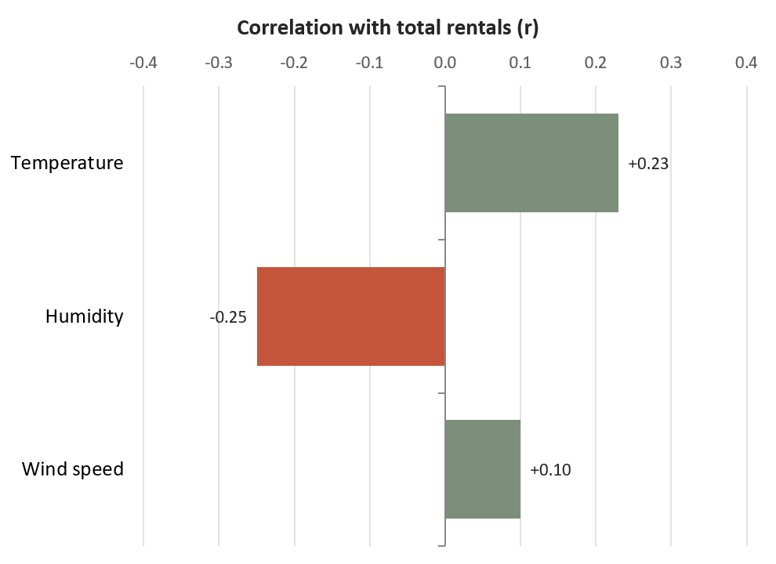
Humidity suppresses demand, warmth lifts it
Humidity, r = −0.25
Damp, heavy air goes with fewer rides.
Temperature, r = +0.23
Warmer hours lift rentals. Values are normalised to 0–1.
Wind speed, r = +0.10
Close to no effect.
All three are weak (|r| < 0.3): time of day matters more than weather.
WEATHER VARIABLES
12
Notes:
Correlation of each weather variable with total customers.
13

Slide 13
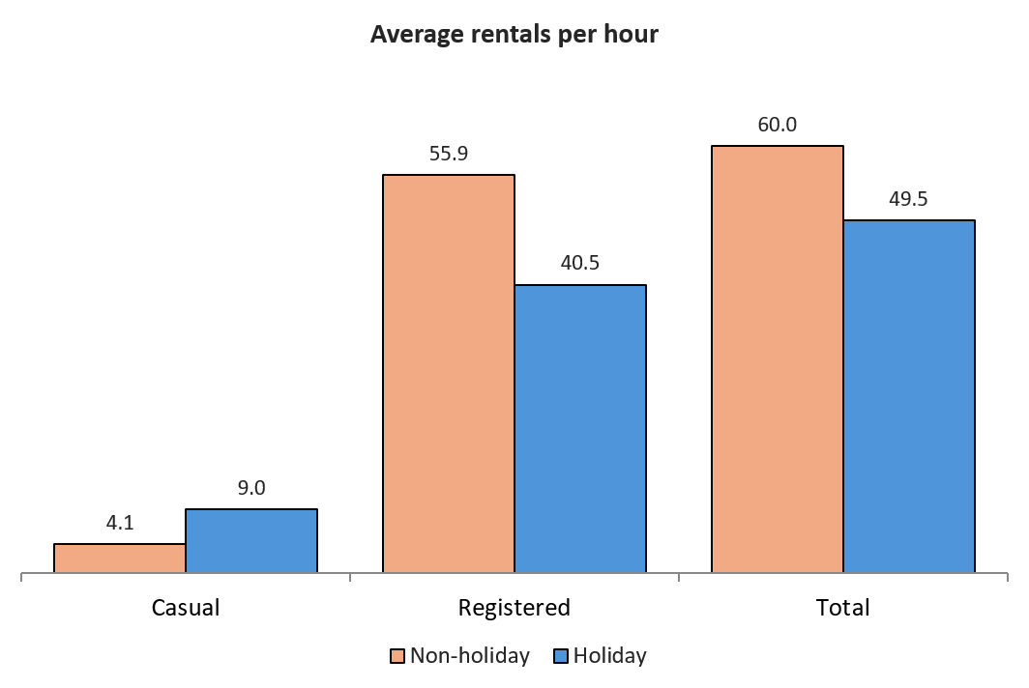
Holidays shift who rides, not just how many
-17.5%
Total rentals per hour on holidays (49.5 vs 60.0)
+120%
Casual rentals on holidays
(9.0 vs 4.1)
-28%
Registered rentals on holidays (40.5 vs 55.9)
HOLIDAY EFFECT
13
Notes:
Holiday versus non-holiday averages.
14

Slide 14
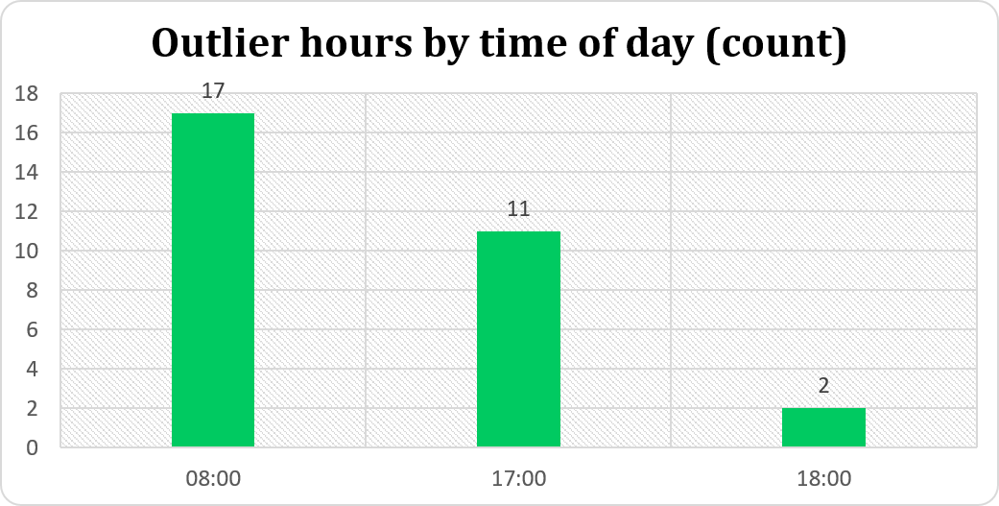
Thirty extreme hours, all at weekday rush times
30
High outliers by the IQR rule, 3% of all records
183.5
IQR upper limit: Q3 of 83 plus 1.5 × IQR of 67
160.3
Mean + 2σ boundary (58.3 + 2 × 51.0), flags 60 hours
All 30 outliers fall on Monday to Friday, none on weekends, and 18 of them happened in normal weather.
ANOMALY DETECTION
14
Notes:
IQR and standard deviation limits from the anomaly sheet.
15

Slide 15
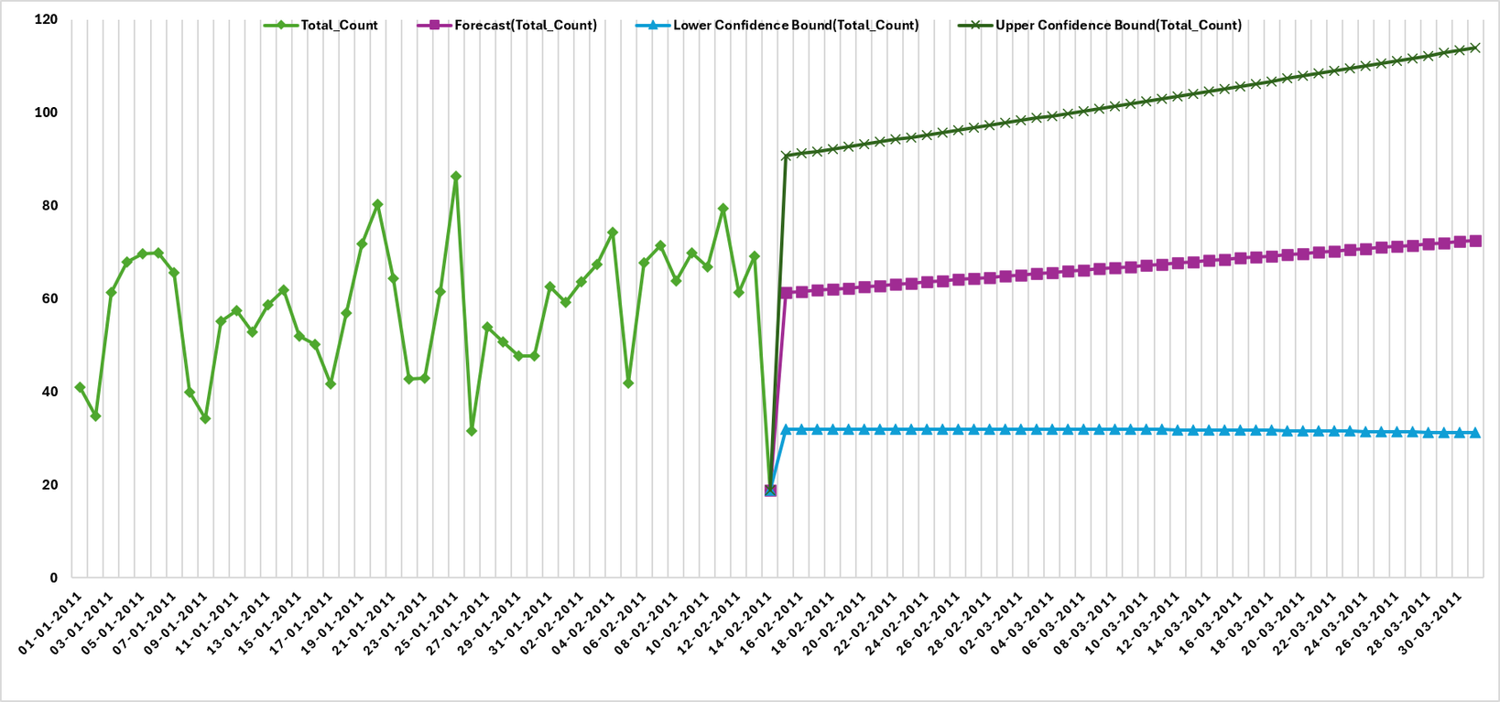
Demand is forecast to drift up 18% by 31 March
Forecast Horizon
15th Feb - 31st March
Historical Volatility
Daily bike rental counts (Jan 1 – Feb 14) fluctuate heavily between 32 and 86 without a fixed upward or downward trend
Anomaly
A sharp, extreme drop occurs on February 16, 2011, plunging to a low of approximately 19
Forecast
Following the anomaly, the model projects a steady, gradual recovery and upward trend through the end of March 2011
FORECAST
15
Notes:
Excel forecast sheet: average rentals per hour, 15 Feb to 31 Mar 2011.
16

Slide 16
Findings from the dashboard
01
Registered riders dominate
02
Demand follows the commute
91.6% of rentals; casual riders are only 8.4%.
The 8:00, 17:00 and 18:00 hours drive 28.9% of volume.
03
Weekdays beat weekends
04
Severe weather hurts
63.3 vs 48.1 rentals per hour, a 24% gap.
Orange-alert hours average 46% fewer rentals.
05
Holidays change who rides
06
Spikes are predictable
Casual riders more than double; registered fall 28%.
All 30 outliers hit weekday rush hours; forecast trends up 18%.
KEY FINDINGS
16
Notes:
Summarise: who rides, when, and what moves demand.
17

Slide 17



Four actions the data supports
Stage bikes before the peaks
Pre-position fleet and docks ahead of 8:00 and 17:00 on weekdays.
Convert casual riders
Target weekend and holiday riders with membership offers.
Plan around severe weather
Scale fleet and staffing down for Orange and Red alert hours.
Maintain in the quiet hours
Schedule servicing between 1:00 and 5:00, when demand is under 11 rentals per hour.
RECOMMENDATIONS
17
Notes:
Each action follows directly from a finding.
18

Slide 18

Thank you
Notes:
Close and open the floor for questions.
20

